Slide 1
Assessing Users’ Engagement with University Library Social Media
Khairil Izwan Hasan¹ and Khairul Hafezad Abdullah²
15 Februari 2023
¹Perpustakaan Dato’ Jaafar Hassan, UiTM Cawangan Perlis
²Science Laboratory Unit, UiTM Cawangan Perlis

Slide 3
Agenda
01
Introduction
Background, Problem Statements, Research Objectives & Research Questions, Significance of the Study
02
Related Literature
Undergraduate library users, Undergraduate students' social media use, Library social media marketing, Students' social media needs and preferences
03
Theoretical and Research Framework
Elaboration Likelihood Model (ELM)
04
Methodology
Research Design, Population and Sample, Data Collection, Variable Measurement, Statistical Method

Slide 4
Background of the study
Social Media
A group of internet-based applications that build on the ideological and technological foundations of Web 2.0, allowing the creation and exchange of user-generated content (Kaplan & Haenlein, 2010)
Social Media Application
Over the last 15 years, social media (SM) tools (websites and applications) have enabled boundary less two-way communication between the content producer and the consumer (Polger & Sich, 2019)
Library Social Media
Libraries use social media for diverse purposes, ranging from advertisement, marketing, promotion, collaboration, and engagement (Del Bosque, Mitola, Skarl, & Heaton, 2017).
University libraries
Collaboration with customers and communities with potential for genuine relationship building as well as a deeper understanding of customer needs (Winn, Rivosecchi, Bjerke, & Groenendyk, 2017).
Social Media Marketing
Social media marketing is defined as a form of marketing that utilises social networking sites and other similar platforms for marketing to online communities and social networks (Rouse, 2016).

Slide 5
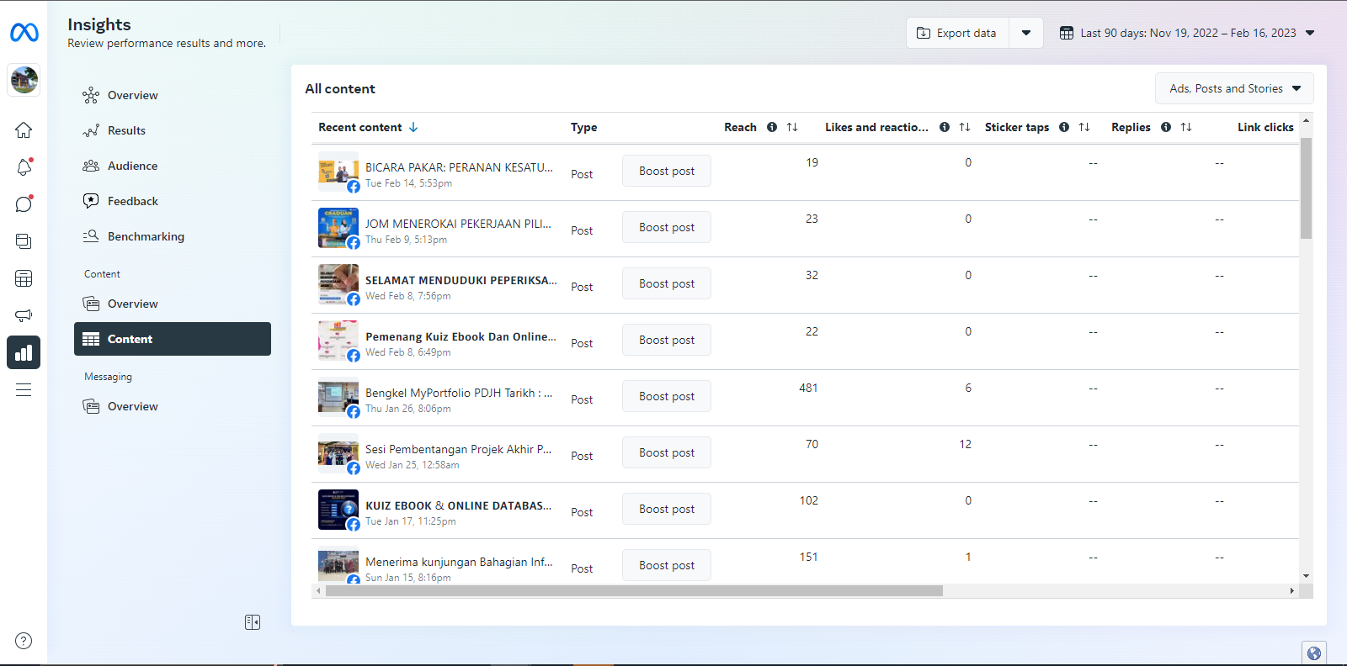
Problem Statement
PDJH Facebook records low users engagement ;likes and reactions, replies, sticker taps, links click (Source: Facebook Insight, 2023)
Lack of understanding of whether students are aware of the library's attempt to reach them and little is known about their willingness to interact with the library on social media. (Ihejirika et al., 2021)
Unclear about students' social media needs and preferences, this is equivalent to shouting into a void and a recipe for ineffective social media marketing activities (Peacemaker, Robinson, & Hurst, 2016).

Slide 6
Related Literature
Undergraduate Library Users
Undergraduate Students' Social Media
Library Social Media Marketing
Students' Social Media Needs And Preferences
Undergraduate students born (1982 and 2000) have grown up in a digital world (Potnis, Deosthali, Zhu, & McCusker, 2018)
Undergraduates in general, remain unfamiliar with the resources and services that their library offers (Adeniran, 2013; Sowole, 2011)
low or non-use of library resources and services by undergraduate students (Del Bosque et al., 2017; Goodall & Pattern, 2011; Potnis et al., 2018).
Boer, Stevens, Finke- nauer, and Van Den Eijnden (2020) confirms the increased use of social media among young adults
Kim and Sin (2016) found that undergraduate students use social media for finding solutions, getting background information, and checking facts online
Significant transition in the mode of information service delivery, particularly that related to user-librarian communications and interactions (Quadri & Idowu, 2016)
EBSCO survey revealed the primary goals of libraries' social media involvement were: maximising library exposure; modernising the library image and e-reputation; promoting specific content offers; building discussion groups and collaborative work; reaching a new audience of potential users; and publishing library news and press re- leases (Luo, Wang, & Han, 2013).
Burhanna, Seeholzer, and Salem (2009), for example, suggest that focusing on marketing efforts via social media would likely be a misallocation of resources
Stvilia and Gibradze (2017) showed that students considered library social media postings related to operations updates, study support, and events as the most important.
Polger and Sich (2019) found that students preferred to read about news and current events, followed by announcements about new library services

Slide 7
Research Question & Objectives
Significance
What is the level of students' awareness of library social media?
To determine the level of undergraduate students' awareness of library social media
RQ1
RO1
What are students' needs and preferences for interacting with the university library on social media?
To determine the students' needs and preferences for interacting with the university library on social media
RQ2
RO2
Improvement of social media presence
Engagement strategy through needs and preferences
Adopting best practices to improve perception
What factors promote and/or hinder undergraduate students' social media engagement with the university library?
To determine factors promote and/or hinder students' social media engagement with the university library?
RQ3
RO3
RESEARCH GAP
Previous study by Shafawi and Hassan, 2018 in a Case of User Engagement in Selected Public and Academic Libraries in Malaysia did not include the current social media; Whatsapp, Tiktok and Instagram

Slide 8
Theoretical Perspectives
Central Route
The Elaboration Likelihood Model (ELM) of persuasion developed by Richard E. Petty and John T. Cacioppo (Hur, Kim, Karatepe, & Lee, 2017) provides a fairly general framework for organising, categorising, and understanding the fundamental processes underlying the effectiveness of a persuasive communications, a symbolic process in which communicators try to convince other people to change their attitudes or behaviours regarding an issue through the transmission of a message in an atmosphere of free choice Warren, Becken, & Coghlan, 2017)
Argument Quality
+
+
Elaboration
Likelihood
Changed Attitude
-
Peripheral Route
Peripheral
Cues
+
Elaboration Likelihood Model (Petty & Cacioppo, 1986)

Slide 9
Research Framework
Driven by choice, functionality, and aesthetic; Facebook, Instagram etc.
Student social media preferences
Perception of social media users; argument quality, personal relevance, and attractiveness of posts
Perceived social media post features
Students engagement
Kind and nature of information a user would like to see; news, events etc.
Information preference of students
Quantified:
video, read comments and view likes/dislikes
user-to-user and user-to-content interaction (commenting, sharing, liking, disliking)
contacting/interacting with the library on social media
Students attitude about the library
Independent Variables
Dependent Variables
(Ihejirika et al., 2021)

Slide 10
Research Methodology
Questionnaire: 17 questions
Procédure: Google Form Distribution
03
01
Quantitative research and survey design.
03
01
05
05
Data
Collection
Research Design
Statistical Package for Social Science (IBM SPSS)
Analysis: Descriptive and Multiple regression
Analysis
04
Variable
Measurement
02
02
04
Population and Sample
UiTM Cawangan Perlis Undergraduate Students (N: 6,503), Executive Information System, 2023
Krejcie and Morgan (1970) sample size decision (S: 361)
Technique: Simple Random Sampling
Likert scale and
multichoice responses

Slide 11
Thank You
Insert the Sub Title of Your Presentation

